Slide 1

Barcode/QR Code Technology
Presentation by: EEE B3
-Vivek Ranjan 1NH18ME124
-Barathesh Shiradoni 1NH18EE707
-Pavan R 1NH18ME086

Slide 2
INTRODUCTION
The electro magnetic waves are radiated into space which are received by the antenna on the receiver
To further store any data the experiment requires aurdino and
Software assist to work as a nft or rfid tag.
The rfid requires a inbuilt battery which charges and discharges while in
contact with the reciver but it is removed and instead a em coils are
Connected to activate the circuit

Slide 3
Roadmap
Abstract
Objectives of project
Litrerature survey
Research gap
Methodology
Implementation schedule

Slide 4
Abstract
IN The supply chain,a warehouse is acrucial component for linking all linking all chain parties . It is necessary to track the real time resource location and satus to support warehouse operation effectively.There fore, RFID technology has been adopted to facilities the collection and sharing of data in a warehouse environment. However ,an essential decision should be made on the type of RFID tags the warehouse managers should adopt,because it is very important to implement RFID tags that work in warehouse environment .As a result ,the house enhance the productivity and reduce the operation costs of the warehouse.Therefore ,it is crucial to evaluate the reading performance of all types of RIFD tags which will enhance the operation cost of the warehouse .reading performances of active and passive RFID tags ,which is battery-resisted with greater sensitivity than passive tags and cheaper than active tags ,has not been examined yet in a warehouse environment .This research is in progress research and it seeks to (1) provide a general overview of the existing real-time data management techniques in tracking warehouse resourses location (2)provide an overall conceptual framework that can help warehouse managers to choose the best RFID technologies for a warehouse environment (3)finally,the paper submits an experiment design for evaluating the reading performance of semi-passive RFID tags in a warehouse environment .keywords:radio frequency identification (RFID), reading performances, locating warehouse resources.

Slide 5
Objectives of project
The main objective of this project is basically about scanning the QRcode and is much more technical which replaces keyboard data entry because bar coding is much faster and more accurate than keyboard data entry. Its main advantage is that if it has any defect in its code then if it is shaked on its code then it scans the defect also.

Slide 6
Litretaure survey
It is a method of representing and storing data in a visual for eg- small images of lines that are machine readable form.
Barcode is a code consisting of group of primted and variously patterned bars and spaces and sometimes numerals that is designed to be the scanned and read into computer memery and that contains information as identification about the object it labels.
QR Code is a matrix barcode or two dimensional code readable by QR scanners, mobile phones with a camera, and smartphones etc.
Scanners is a device that interpret different imagery, in this case it is barcodes.

Slide 7
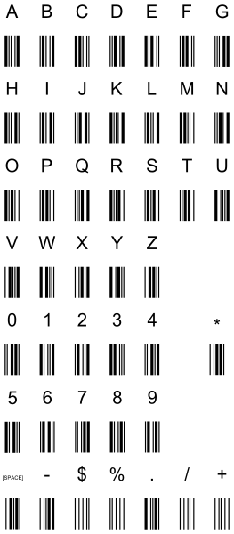
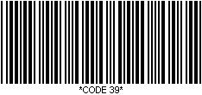
Different Codes
Code 39
Defines 43 Characters.
Typically used in non-retail areas.
Arguably the simplest barcode.

Slide 8
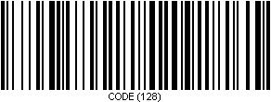

Different Codes
Code 128
Defines the entire 128 ASCII character set.
Typically used in shipping/retail.
QR Code
Most commonly used barcode as of recent especially with mobile phones.
Has various numbers of functions: linking to websites, send SMS functions, etc.

Slide 9



Working of scanner
Light from Scanner
Light Reflection
Barcode scanners are made of 3 different parts: an illuminator, a convertor, and a decoder.
The illuminator shoots out a line of light (typically red) at the barcode.
Light will reflect from the barcode (from anywhere that is not black) in the form of a wave.
The convertor converts the wave into a readable form for the device.
Decoder reads the converted information.
Barcode

Slide 10
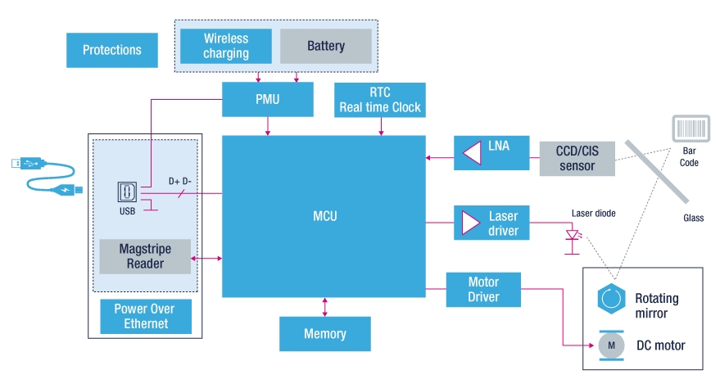

Slide 11
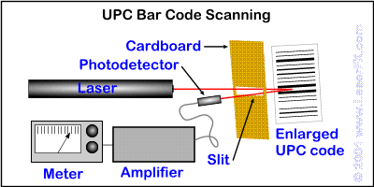
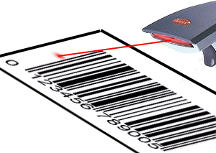

Slide 12

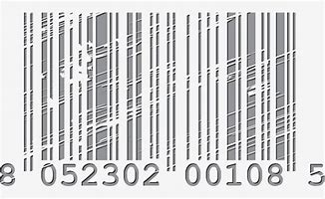
DISSADVANTAGE OF BAR/QR CODES
Linear bar codes can store only small amount of data
Barcodes once distorted cannot be used properly
Needs special devices to decode the informations
Only works works with computer or POSterminals
Do not has read/write capability
It is labour intentive as it requires to be scanned individually
Scratched or crumpled bar codes causes problem while scanning

Slide 13
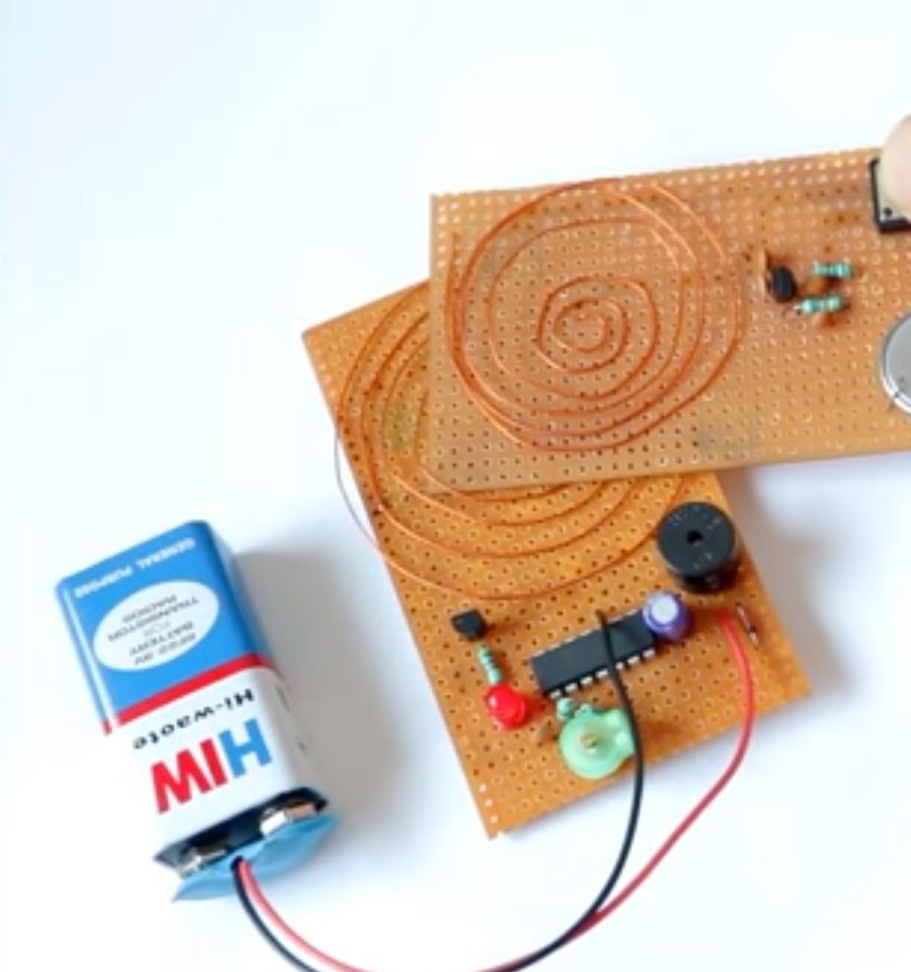
Research gap
TO INCREASE THE ACCURACY, SPEED AND HILGH DURABILITY
A radio frequency wave generator can be used to generate radio signals.
Which can replace the bar/qr codes.

Slide 14
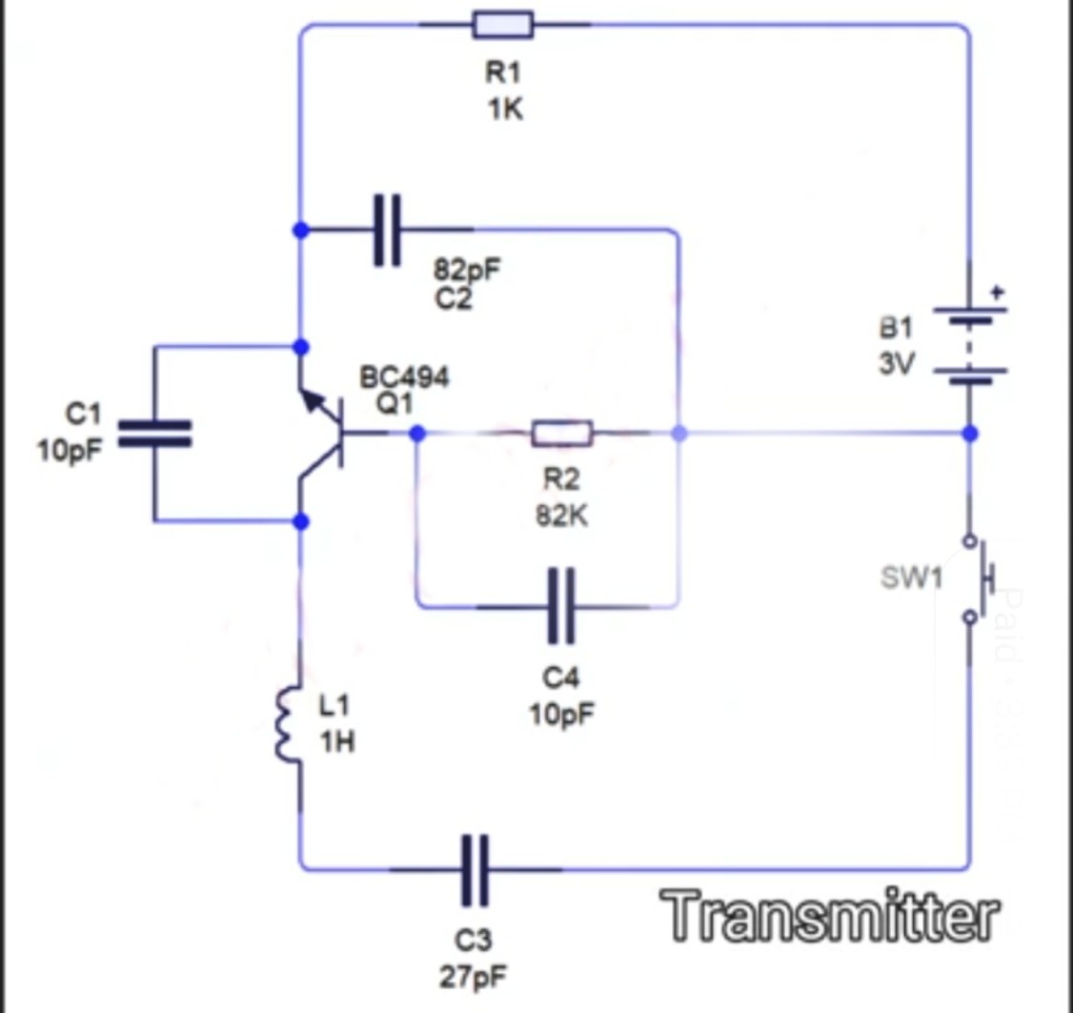
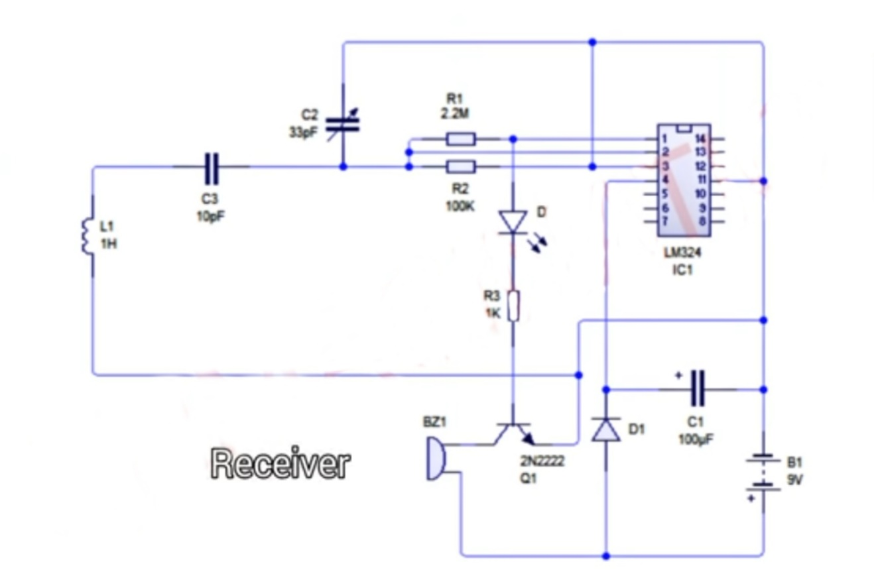

Slide 15
Methodology
The methods and the tools required in this project are as follows-
Inventory Control
Barcode Scanner
Decoder
Printing Software
Communication Software
Database of library Holdings
Library Software
Membership Database
Personal Computers
Inventory Control-Its working is to control the parts.
Barcode Scanner-Its working is to scan the QR code for required operation.
Decoder-It decodes the scanner which forms and does the further simplification.
Printing Software-It is the software which prints the scan into analysed form.
Communication Software-It is the software which does all the communication.
Database of library Holdings-It provides the database for the further proceedings.
Library Software-It is the software which provides the necessary required tools for the working.
Membership Database-It is one kind of database which needs to be operated at a particular time.
Personal computer-A computer as required to do the codings and for the whole project.

Slide 16
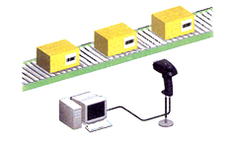
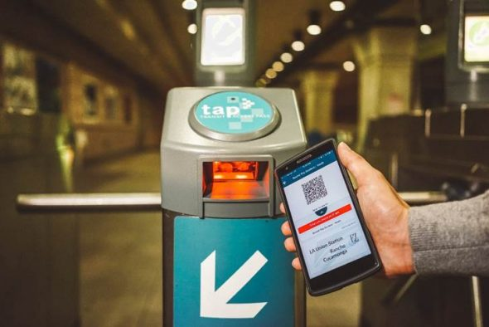
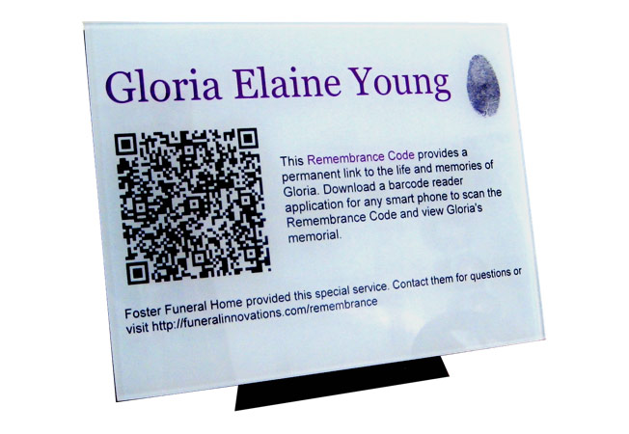
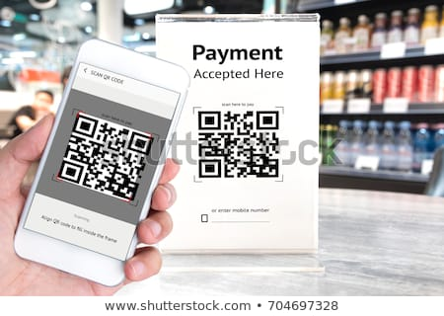
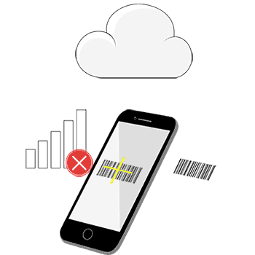
Applications of QR/BAR CODERS

Slide 17
Questions
Email List Segmentation
Employee Attendance and Time Tracking
Social sharing
Package Tracking
Connecting BRICK & MORTAR
Digital marketing
Graphic Analisys
Assest Management
?

Slide 18
CONCLUSION
Implifications automated and barcode technology is one of the best techniques to minimize the time taken at the circulation center.
Barcoding by itself is not system but an identification tool that provides an accurate and timely support of the data requirement for the sophisticated management systems.
The barcode usage increases accuracy in the data collction, save time of the users and the staff and improves efficiency in various library operations.Every library needs the application of new technology to develop its existing methods. This time thus saved can be utilized for developing advance and additional techniques in the library.
Contribution of barcode technology with computer and application software improves performance and efficiency in various library operations.

Slide 19
THANK YOU

